Slide 1

Stage 2 Revo Game Strong Course Designer: Jay Slater
Revo Game Strong is a 12 round, 60 point Comstock Short course. There are 6 USPSA targets. The best two hits per target will score. The start signal is audible.
The Handgun start position is standing anywhere with wrists below belt. Handgun is loaded and holstered. The PCC start position is standing anywhere with PCC loaded, safety on, stock on belt.
On the audible start signal, engage all targets from within the shooting areas.

Slide 2
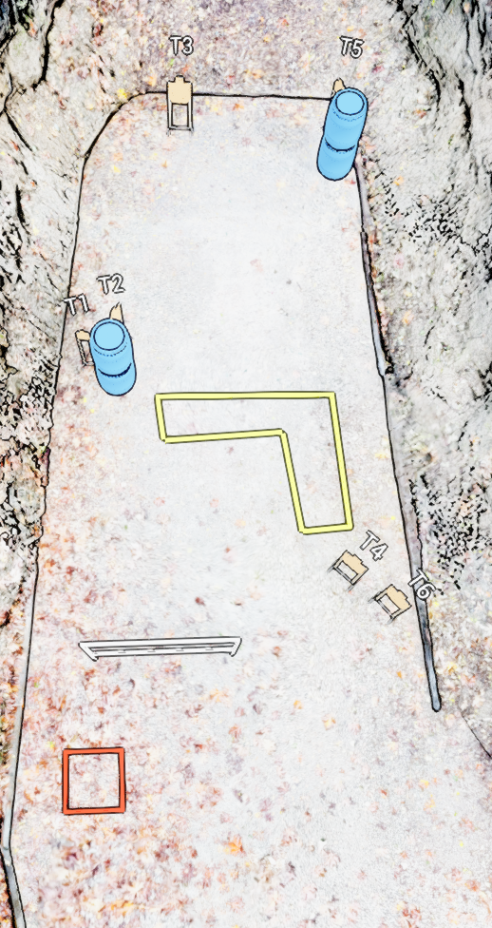
 | Stage 2 Revo Game Strong Course Designer: Jay Slater

